Slide 1
The Art of the Possible:
Fully Digital Ecosystem powered by DPI
Edward Cable, The Mifos Initiative
@edcable
David Higgins, Brook IT Consulting Ltd.

Slide 2
Agenda & What You’ll Learn
About Mifos and Team
Mifos DPG Stack
Enabling DPI
Core Banking
Payment Hub EE - A Closer Look
Art of the Possible - Shared Infrastructure
G2P - Achieving Harmony
GovStack Pay-BB
G2P Connect
Lab Environment
Demo - Art of the Possible - G2P
ID Account Mapper
Bulk Processor
Disbursement
Roadmap & What’s Next

Slide 3






Edward Cable
President/CEO of Mifos
Guiding global open source community & ecosystem over the past 16 years.
AirBNB SuperHost. Caretaker of menagerie of animals including goats, wolfdog, chickens, rabbits and more.
David Higgins
Programme Manager, Mifos
Guiding our GovStack & G2P Connect Initiatives
More than 23 years experience managing Enterprise IT and large scale development programmes in the Telecommunications, Financial Services and Fintech sectors

Slide 4






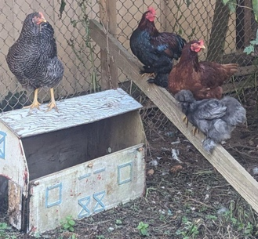

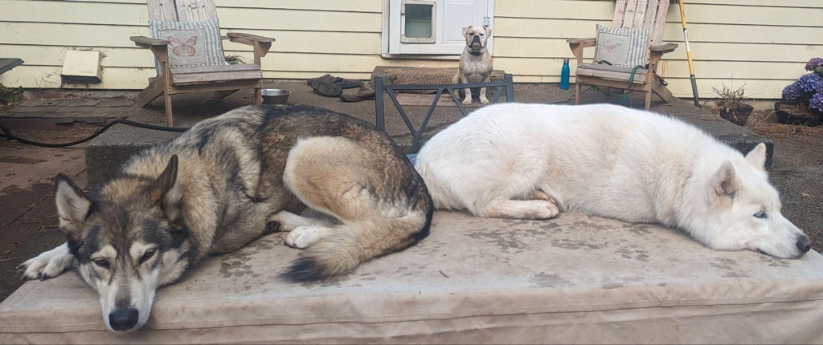

Slide 5

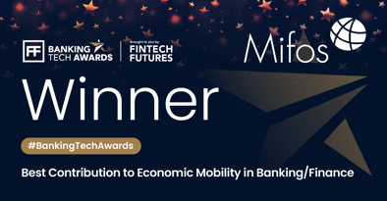
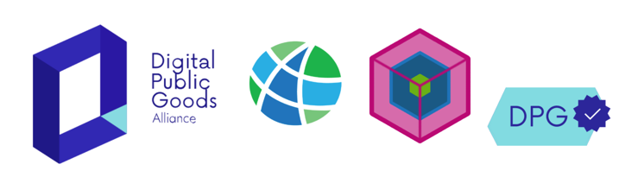

About Mifos
Global 501(c)3 fintech nonprofit.
Mission. Scale the development and impact of inclusive fintech through an open community to advance financial health of 3B underbanked.
Vision. 3 Billion Maries
Impact: 25m individuals across 500 orgs reached.
How We Do It:
Commoditize core banking software.
Virtuous cycle of upstream contribution
Global ecosystem of market-driven solutions

Slide 6




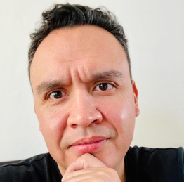

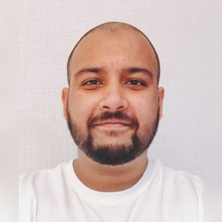
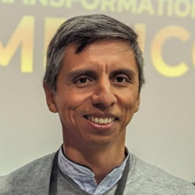






Mifos Consortium - GovStack Delivery Team
Ed Cable
President/CEO
Jose Alberto Hernandez
CTO
Soban Najam
Program Manager
David Higgins
Programme Manager
Manoj VM
CTO
Victor Romero
CEO
Avik Ganguly
CEO
Karim Jindani
CEO

Slide 7






How do the Mifos DPGs enable DPI?
Reduce Barriers to IIPS Adoption
Enable Effective G2P Payments
Widespread Financial Inclusion
Modern Core Banking
DFSP Participation Engine
Payment Orchestration
Functional Wallets & Transaction Accounts
Meaningful Usage of Financial Services
Advancing Financial Health
Impact Stays Local

Slide 8
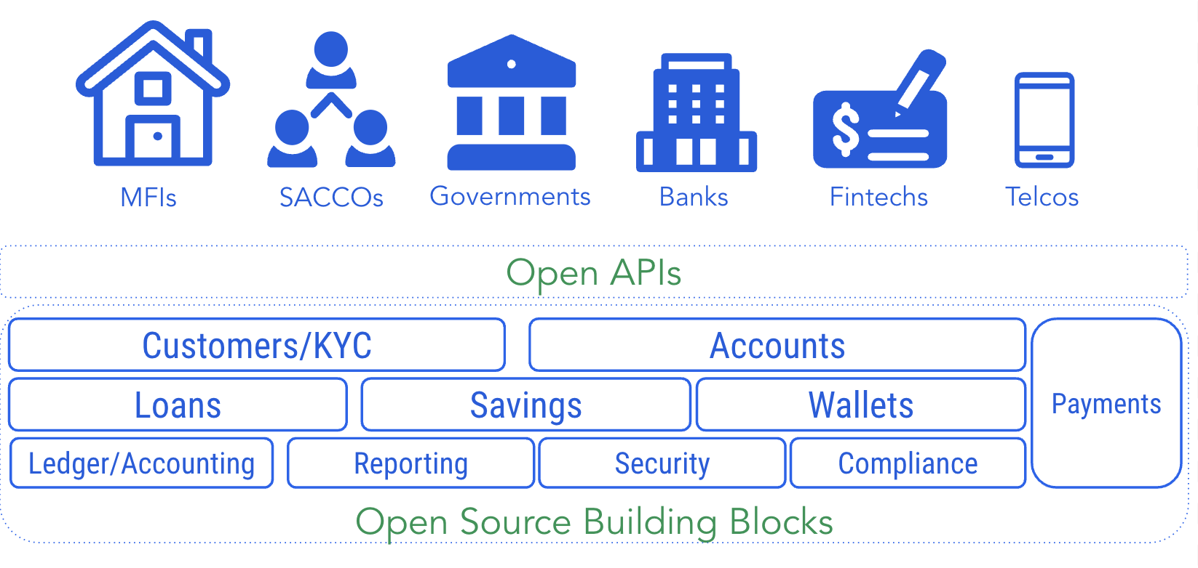

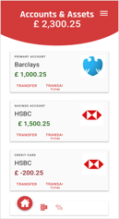
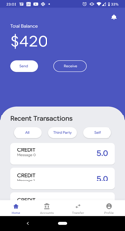
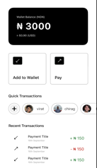
Mifos DPG Stack
Payment Orchestration
Core Banking & Account Management (Mifos/Fineract)
Pay-BB
(Government)
Core Banking System, Account Management & System of Record
Open Banking APIs
Payment Hub EE
(DFPS Participation)
UI
Channel Connectors
ID-Account Mapper
Payment Connectors
Core Banking Connectors
ISO 20022
Process Orchestration
Fineract
Bulk Processor
Mojaloop
SACCO
Momo
Wallet
RTP
CBS 1
Orchestration
FARM Connectors
Reference Mobile Banking
& Wallet Apps
Open Banking App
Mobile Banking
Mobile Wallet

Slide 9
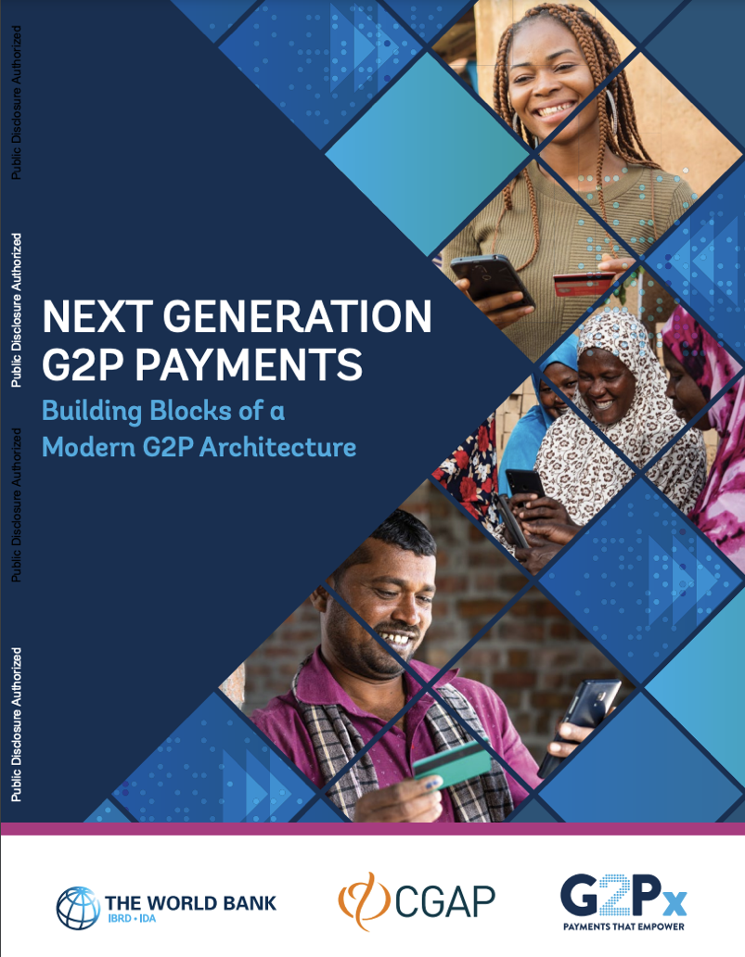
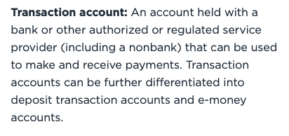
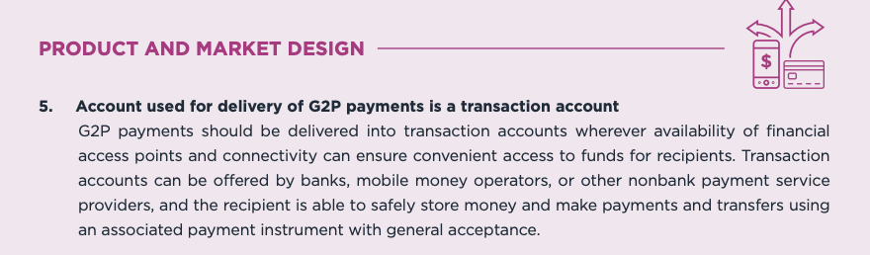
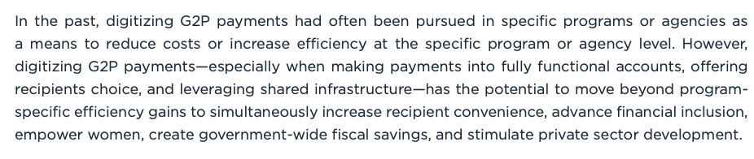
Fundamental Importance of Transaction Account (Functional Wallet or Account)
“In an ideal scenario, this will entail leveraging fully functional accounts that can serve as a gateway to other financial products and services, which can improve their financial lives and allow recipients to receive payments into an account of their choice.”

Slide 10
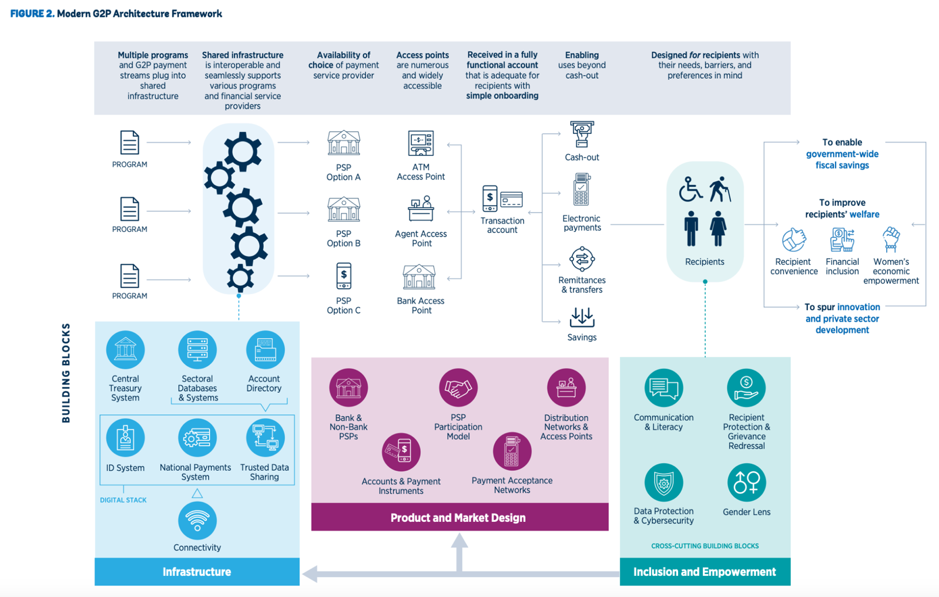
Building Blocks of Modern G2P Architecture (World Bank)
Mifos/Fineract
Payment Hub EE
Payment Hub
Mifos/Fineract

Slide 11
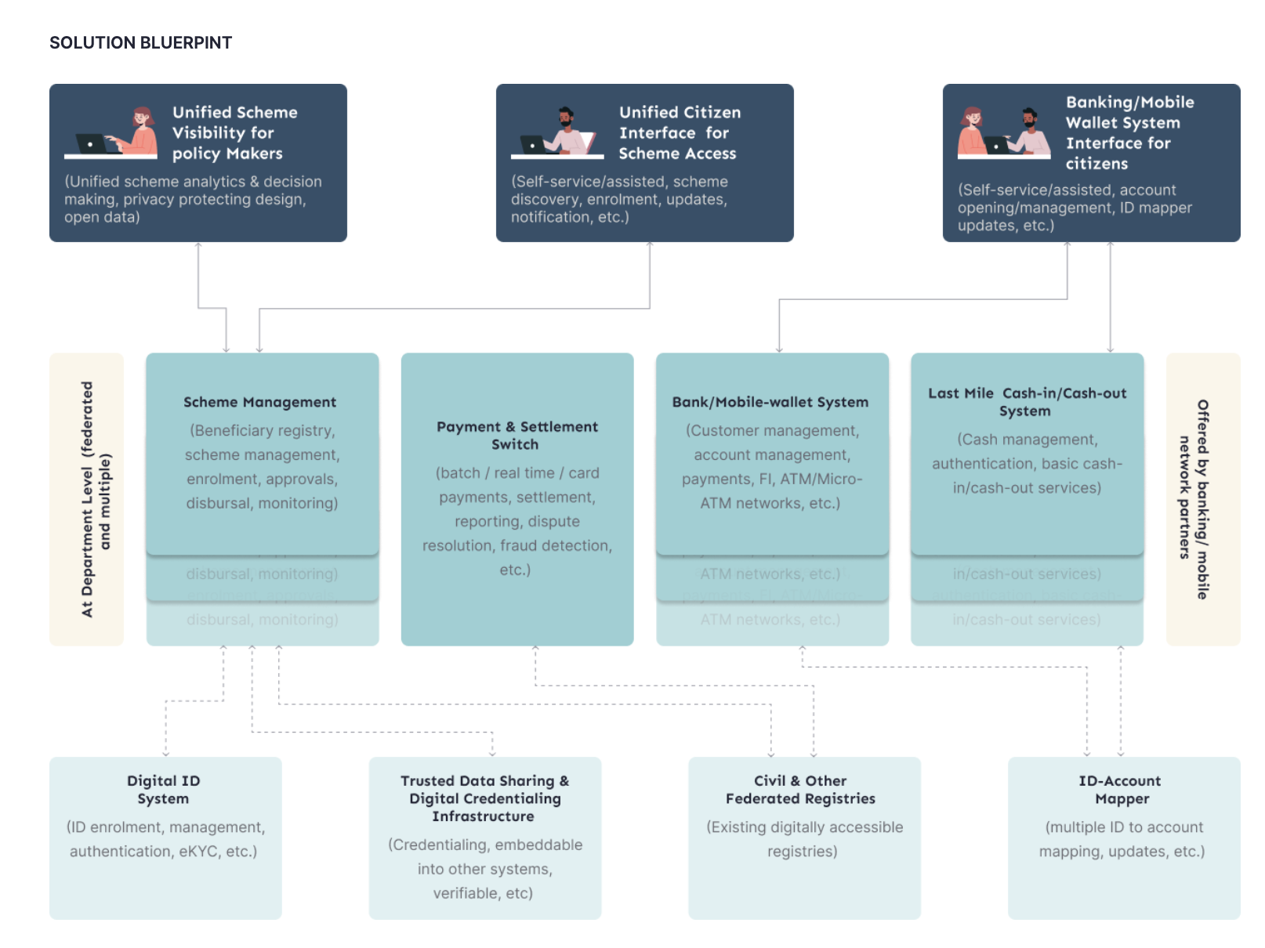
G2P Connect Solution Blueprint

Slide 12
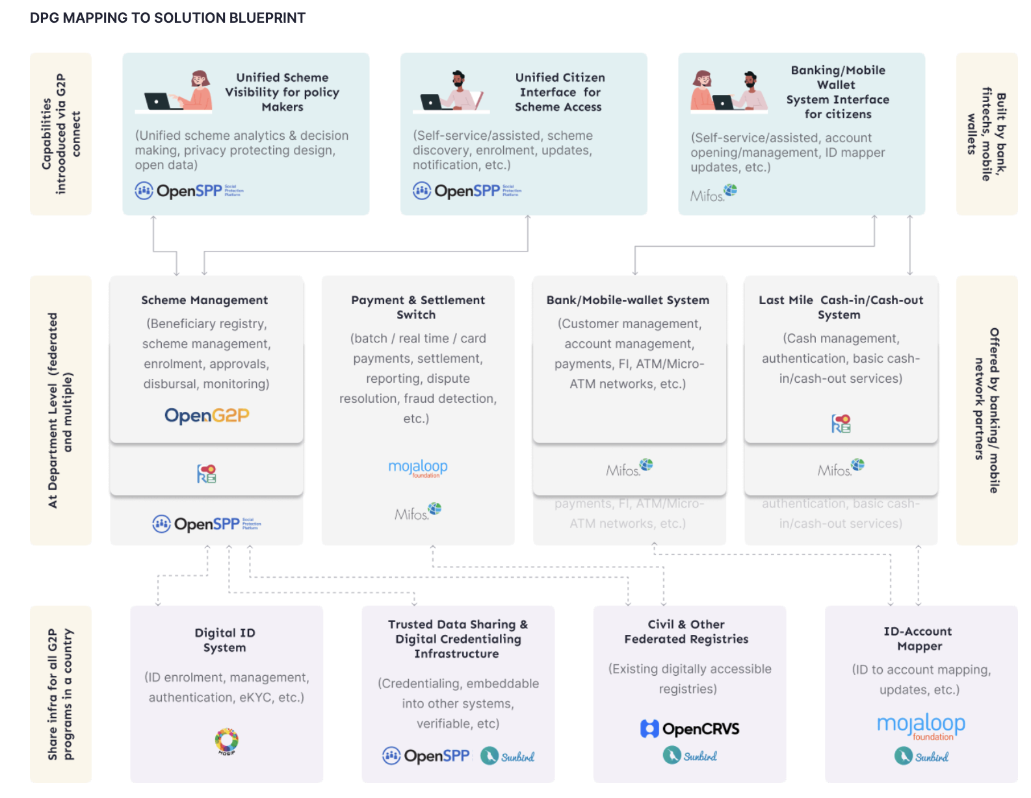

G2P Connect Solution Blueprint

Slide 13




DPI Extends across the Entire Ecosystem
Fintechs/PISPs
Mifos Open Banking API
GSMA MM API
Mojaloop PISP API
Apps
DFSPs
Accounts
Mifos/Fineract
OS Core Banking API
Rails
Switch Operator
Mojaloop Open API

Slide 14


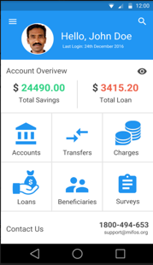
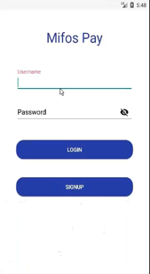



Four Layers of APIs at 2 Different Levels
Rules
Rails
Accounts
Apps
Payment Hub EE
Open Banking APIs
GSMA Mobile Money APis
Mojaloop PISP APIs
Infrastructure
Application

Slide 15
Payment Hub EE & Fineract
Fineract Core Banking
Customer Management
Wallet/Account Management
Mifos Orchestrator
(PH-EE)
KYC/Identity
Notifications & Messaging
Loan Origination
Payment Connectors
Zeebe
Channel Connectors
Loan Management
Disbursements & Collections
Fees, Charges, Commissions
Moov
Process Orchestration
Mojaloop
Core Banking Connectors
General Ledger & Accounting
Treasury Management
Audit & Internal Control
M-Pesa
Workflow Engine
UPI
Business Intelligence
Social Performance
Fraud & Risk Management
Kafka
Audit Streamer
Operations Streamer
ElasticSearch Kibana
DB
Multi-tenant Data Store

Slide 16
Core Banking System
Fineract Core
Customer Management
Account Management - Product & Portfolio Engine
KYC/Identity
Data Tables
Workflows
Loan & Credit Products
Deposit & Transactional Accounts
Share/Equity Accounts
Notifications & Messaging
Disbursements & Collections
Batch Processing
Interest Calculation
Fees, Charges, Commissions
Payment Allocation Logic
Integrations & Extensibility
Security
REST API
Real-Time Event Framework
Webhooks
Authentication
Authorization
User Management
Reporting & Analytics
Accounting
Dashboards & Visualizations
Operational & Management
Regulatory
Ledger
Financial Account Mappings
Treasury & Cash Management
Portfolio Servicing
Audit & Internal Control
Arrears & Aging
Delinquency Management
Rescheduling
Audit Log
Org & Entity Management
System Administration

Slide 17
Pepper Soup Project

Slide 18
Leading Global Fintech replatforms its loan management system of record from Temenos to Fineract because costs too high, growth constrained, and lacked control.
Pepper Soup Project
Project Timeline :
2021: 3 month POC proving 1000 TPS for loan creation, 8000 TPS for loan read, COB for 2M loans in under 30m
2022: Development & Rollout of Upstream into Downstream
2023: Go-live in April. 200K new loans daily; 100M for 2024
2023-24: Development/Rollout of Product #2 into 6 markets.
Key Metrics
 | Mifos/Fineract | Temenos
Cost Per Loan | $ .02 | $ .31
Create Loan API | 460ms | 3100ms
COB Loan Processing | 1040 accounts/s | 650 accounts/s
Solution:
Mifos & BaaSFlow teams built significant OSS contributions into the upstream codebase as public good.
PostgreSQL/EclipseLink support, Fineract Instance Pods Reliable Event Framework on Kafka, Spring Batch
All contributions into upstream Mifos/Fineract codebase.
Benefits
Cost Savings - projected $230M in license savings over 5 years by migrating these 2 products.
Increased Performance - Faster Create Loan API call → increase in take rate from 14% to 16%
Smooth Rollout - 1 month ramp up vs 9 months. Built new securitization module in 3 months vs 1 year
Private Sector Achieves Massive Scale, Cost Savings and Vendor Sovereignty while Contributing Upstream

Slide 19
Mexico & SIBI

Slide 20





WHY INFOTEC AND MIFOS COLLABORATION?
MIFOS AND INFOTEC SHARE A COMMON GOAL BASED ON SOCIAL INCLUSION AND ACCESIBILITY OF FINANCIAL SERVICES TO THE POOREST PEOPLE.
ALL OF THIS SUPPORTED BY AN OPEN SOURCE COMMUNITY.
OUR COLLABORATION HAS ENABLED INFOTEC TO INCREASE ITS TECHNOLOGICAL CAPABILITIES, WITH THE SUPPORT OF MIFOS ALLOWING THE DEVELOPMENT OF A FUNCTIONAL, COMPETITIVE, AND COST-EFFECTIVE BANKING SOLUTION FOR THE GOVERNMENT.

Slide 21

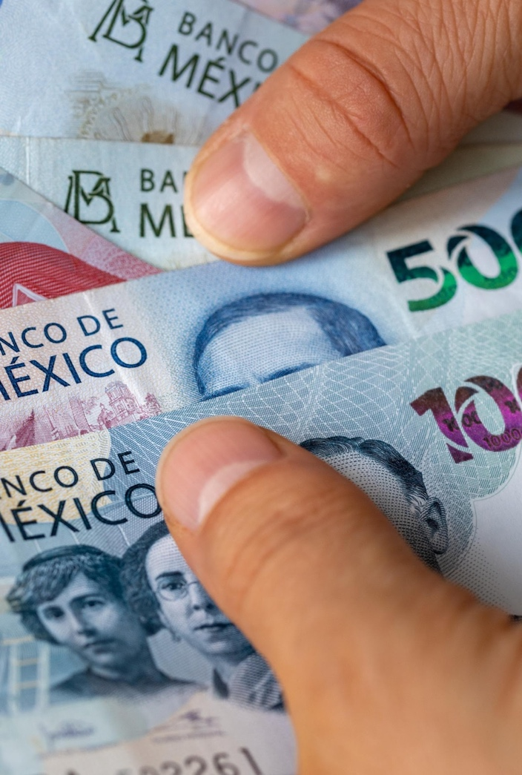
ABOUT SIBI
THE OPEN CORE BANKING FOR MEXICAN GOVERNMENT (SIBI), IS AN ECOSYSTEM BASED ON OPEN-SOURCE TECHNOLOGY MIFOS I/O THAT MERGES TRADITIONAL BANKING WITH DIGITAL BANKING.
GOALS
IT WILL CONTRIBUTE TO FINANCIAL INCLUSION IN MEXICO.
IT WILL ENABLE FINANCIAL INSTITUTIONS TO PROVIDE BANKING SERVICES MORE EFFECTIVELY AND EFFICIENTLY.
IT OFFERS A SCALABLE PLATFORM WITH THE CAPACITY FOR GROWTH AND FUNCTIONAL ADAPTABILITY IN LINE WITH CHANGING CUSTOMER AND BUSINESS NEEDS.
THE TECHNOLOGICAL ARCHITECTURE IS BASED ON CONTAINERIZED MICROSERVICES COMMUNICATED THROUGH APIS REST.

Slide 22
























06
THIRD PARTY CONNECTIVITY
FINANCE
TREASURY
ACCOUNTING
INTERNAL AUDIT
PEOPLE
01 BANKING CORE
GENERAL PUBLIC
$
CASH MANAGEMENT
BUSINESS INTELLIGENCE
CUSTOMERS
ELECTRONIC DATA BASE
FINANCIAL EDUCATION
CREDIT REPORTS
SAVINGS
SHARES
REPORTING
COMPANIES
LOANS
ORGANIZATION
USER
CREDENTIALS
ACCOUNTING AUDIT
05
REGULATORS
BANXICO
CNBV
NATIONAL IDENTITY REGISTER
CONDUSEF
INFORMATION SYSTEMS
SHCP
02
TRANSACTIONAL SWITCH
CARDS
INSTITUTIONS
AUTHORIZER
GOVERNMENT
FEDERAL &
LOCAL
MUNICIPALITY
STANDIN
DIGITAL BANKING
REVENUE AGENCY
03
TRADITIONAL BANKING
04
ATM
DIGITAL ASSISTANTS
MOBILE BANKING
INTERNET BANKING
MERCHANTES
WALLET
CHECKS -CECOBAN
REMITTANCES AND PAYMENT ORDER
SPEI-SPID - CODI
CORRESPONDENTS
QR TRANSFERS
APIS OPENBANKING
DEBIT AND CREDIT CARDS
NATIONAL ELECTORAL INSTITUTE
CONTACT CENTER
BRANCHES
SECURITY
FRAUD
BIOMETRICS
TOKEN
ENCRYPTION
PRIVACY
CERTIFICATES
TIME STAMP MARK

Slide 23
SIBI
SCENARIO 1
SCENARIO 2
2,000 BRANCHES COUNTRY WIDE
20 MILLION USERS
UP TO 4 MILLION CARD TRANSACTIONS
UP TO 5,000 INTERBANK TRANSACTIONS PER SECOND
150,000 LOAN APPLICATIONS FILED IN 1 WEEK
1,700 BRANCHES COUNTRY WIDE
2.7 MILLION HISTORIC RECORD IMPORTED FOR DEBT RECOVERY
10 MILLION REPAYMENT TRANSACTIONS
58,000 LOAN APPLICATIONS FILED IN 5 DAYS

Slide 24













TECHNICAL FEATURES
STRATEGIC PLANNING
FINANCIAL INCLUSION
LOCAL BRANCHES
FIELD OFFICERS
CUSTOMERS
USERS
SECURITY LAYER
USERS
ROLES AND PRIVILEGES
REPORTS
PRODUCTS
LOANS
OFFICES
EVALUATION OF APPLICATIONS
NOTIFICATION TEMPLATES EDITION
RECEIPT OF PAYMENTS
GENERATION OF ACCOUNT STATEMENTS
OPENING LOANS ACCOUNTS
CUSTOMER/APPLICATIONS DATA UPDATE
NEW APPLICATIONS
CUSTOMER ENROLLMENT
DIGITAL SIGNATURE
DOCUMENTS OPENING ACCOUNTS UPLOAD
LOANS APPLICATIONS LOANS PAYMENTS
BRANCHES SEARCH
CUSTOMER PROFILE
FRONT
MANAGEMENT
OPERATIONS
WEBSITE
APP MOBILE
WEB
MOBILE
SIBI ECOSYSTEM
^{(BACKOFFICE)}
(BACKOFFICE)
(BACKOFFICE)
(FIELD OFFICER APP)
(WEB)
(ANDROID)
CREDIT PRODUCTS LOG
PAYMENTS LOG
CUSTOMERS DATA OPERATIONAL REPORTS
ACCOUNTING ACCOUNT OPENING NOTIFICATIONS
CORE
SECURITY LAYER
CORE BANKING
REPORTS
SIBI INFOTEC
SECURITY LAYER
DATABASES
DATA MANAGEMENT TOOLS
(SUPERSET)
DATABASES
TREASURY
CARDS, RE-NOMINATION, FUNDING
LOCAL BRANCHES
CONTRACTS, CONTRACTS, PAYMENT VOUCHERS
SECURITY LAYER
LEGACY CHANNELS
CORPORATE BANKING
PHYSICAL BRANCHES

Slide 25

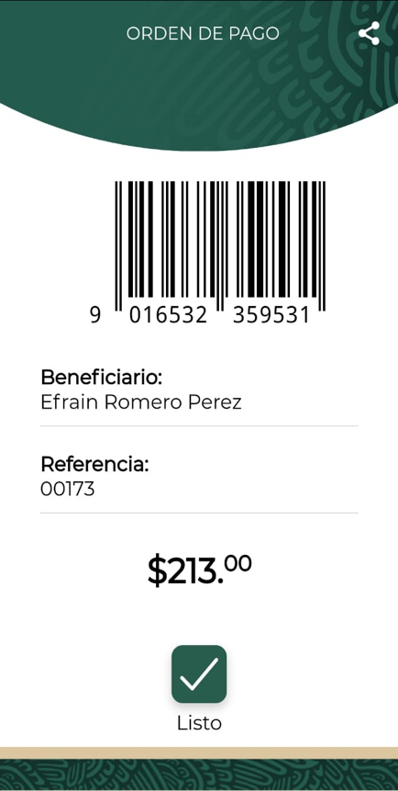
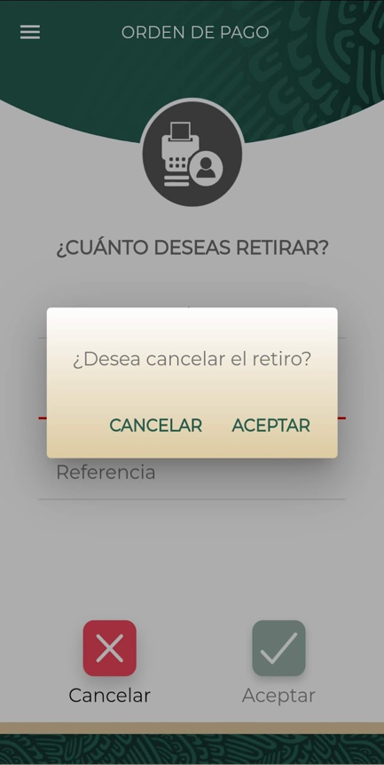
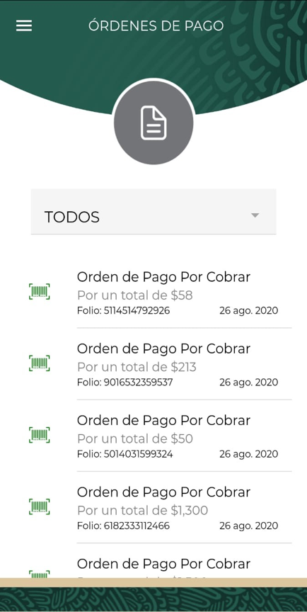
MERCHANT WITHDRAWAL – PAYMENT ORDER
GENERATE PAYMENT ORDER WITH A BAR CODE AND BENEFICIARY NAME
PAYMENT ORDER CAN BE CANCELLED
HISTORICAL TRANSACTION LIST

Slide 26
Payment Hub EE
DFSP Participation Toolkit

Slide 27
Payment Hub EE Orchestration Engine
Mobile App
Web App
Branch FrontEnd App
ATM
POS
CARDS
(ISO8583)
Omnichannel Services for Customer
Payment Schema Connectors
Payment Hub
Multi-tenant
Account Management System Connectors
P A Y M E N T H U B
ISO20022 Realtime Connector
Apache Fineract Connector
SOPORTE MULTI-ENTIDAD
Mojaloop Connector
Process Orchestration
Stateful, Distributed Engine
Apache Fineract CN Connector
Other Payment Connectors
Other Core Banking Connector
Fraud Detection Connector
Fraud Detection Connector 1
Fraud Detection Connector 2

Slide 28
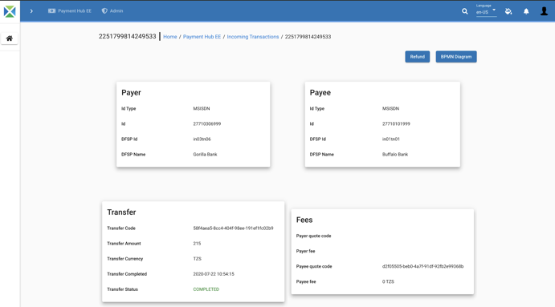
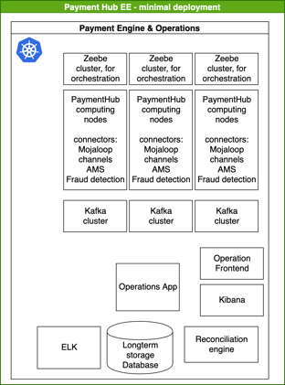
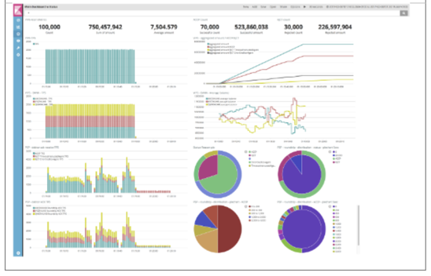
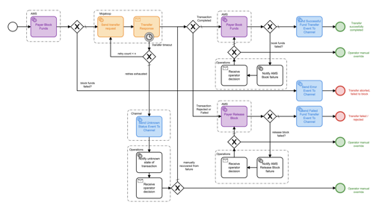

What does Payment Hub EE do?
Integration
Operational Controls
Scalable & Replicable
Payment Schema Connector
Channel Connector
Core Banking System Connector
Orchestration
Analytics

Slide 29
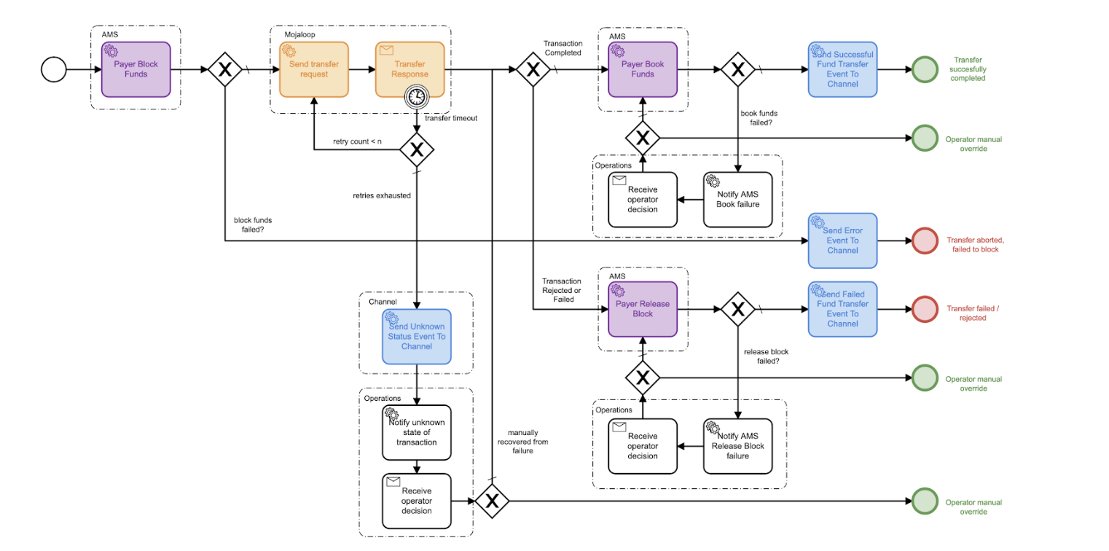
Executable BPMN Diagram in PH-EE

Slide 30
Scalable, extensible, enterprise-grade Operation Control Center for DFSPs
Mifos and Core Banking System agnostic → simply build another connector.
Not just to abstract out the complexity of API integration
Operational Control Center for a DFSP - monitor, analyze, and respond
Scalable and Enterprise-grade, deployable in multiple topologies.
Extensible - powerful bridge to connect to other payment systems.
Zeebe Workflow Engine for Microservices Orchestration - Orchestrate any end-to-end workflow across your payments, systems, and channels
Open Source and extensible - ready to be commercialized by integrators or enhanced and extended by in-house IT
Stand-in System capabilities

Slide 31





Enabling DFSPs of any size to effectively participate in IIPS
Turnkey solution for digitization & digital transformation of MFIs & SACCOs
Challenge
Solution
MFIs lack processes & systems to participate in switch
Cloud solution for digitizing and automating core banking operations
MFIs lack systems with 24x7 capabilities
Mifos/Fineract operates in real-time & Payment Hub EE can provide stand-in processing
MFIs have wide variety of core banking systems and channels
Extensible by simply building additional core banking system or channel connectors.
MFIs learn in visual manner
Hands-on lab environment with actionable tools
Difficulty connecting dozens or hundreds of MFIs
Multi-tenancy of Mifos and Payment Hub EE enabling economies of scale for shared service providers
MFIs need support and training in getting regulated & connected
Mifos network of local on-the-ground integrators & support partners with deployment & domain expertise.

Slide 32







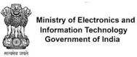










Where is Payment Hub EE being deployed?
ISO 20022 Integration for Instant & Batch Payments (Prod)
FedNow RTP (Test/Pilot)
Bulk G2P Payments Pilot
Stablecoin Gateway (POC)
QR Code Merchant Payments
ISO 20022 Cross-Border POC
Closed Loop Wallet
Mojaloop Integration Lab
Mobile Money Integration (Prod)
Instant payment of tax on transactions (Prod)
Conditional Cash Transfers Pilot

Slide 33
Art of the Possible:
Shared Infrastructure

Slide 34
Vision for Shared Infrastructure
Digitization
Core Banking & Account Management
New Products
Digital Transformation
Digital Channels
Mobile Wallet/Apps
Open Banking/PISP
Digital Payments
Orchestration & Integration
IIPS & Mobile Money
Data Science for Good
Decisioning
AI Support
Alternative Scoring
Reporting
Regulatory
Operations
Social Performance
FARM & Compliance
Fraud Detection
AML/CFT
Audit
Digital Financial Services Platform
Cost Reductions
Eliminate 90% of IT Costs
No software licenses
No support or upgrade fees
No server hardware
Reduce Operating Costs
Reporting
Regulatory
Product development

Slide 35
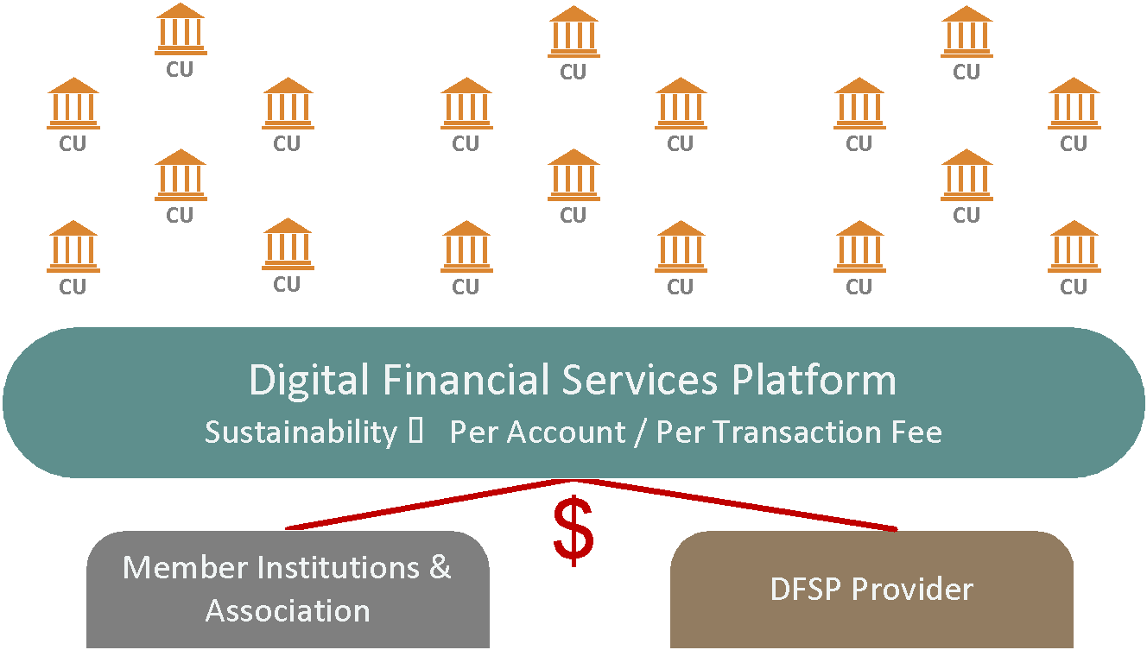

Slide 36
Blueprint for Shared Infrastructure
Impact
Financial Health
Meaningful usage of digital financial services advances measurable long-term impact on financial health
Local Economic Empowerment
Virtuous cycle of value & innovation that circulates through local economy.
3
Distribution & Innovation
Adoption & Sustainability
Regional or National Association/Network of MFIs/SACCOs/Rural Banks, etc.
Deployment, Training & Support
Localization, deployment, training, rollout, support of solution in hosted environment
2
Digital Public Infrastructure
1
Technology
Development, Maintenance & Support of the core Digital Public Goods
Policy & Enablement
Government, funders, regulators committed to digital public infrastructure mindset & investment.

Slide 37










Theoretical Example - Mexico
Impact
Financial Health
Remittances delivered into accounts managed by Mifos and Finerat enabling lending, deposits, and share accounts circulating money locally.
3
Distribution & Innovation
Adoption & Sustainability
Deployment, Training & Support
Digital Public Infrastructure
Policy & Enablement
Technology

Slide 38


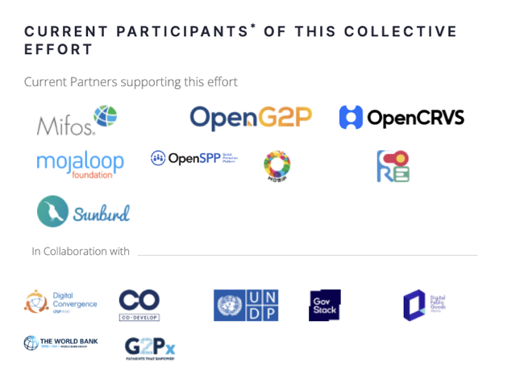


Finding Harmony

Slide 39
Lab Environment

Slide 40
Lab Environment
As part of Mifos commitment to driving DPI and demonstrating the role of DPG’s Mifos is going to invest in its current lab environment to demonstrate a full DPI architecture. This includes non-Mifos DPG instances. The aim being to reduce the burden on users of setting up a hosting an environment to trial out concepts.
Target Audiences are:
Fintech developers (Internal and External) who want to explore how they can integrate Payment Hub into their use cases and scenarios
Developer who wants to understand what Payment Hub EE does and works with other DPGs
Countries looking to build G2P systems using DPG/DPIs
Fintech developer (Internal and External) who wants to develop one of the components with additional features
Testers
Initiative owners who want to demo the end to end DPI
Students and Interns to enable the to contribute day 1.

Slide 41
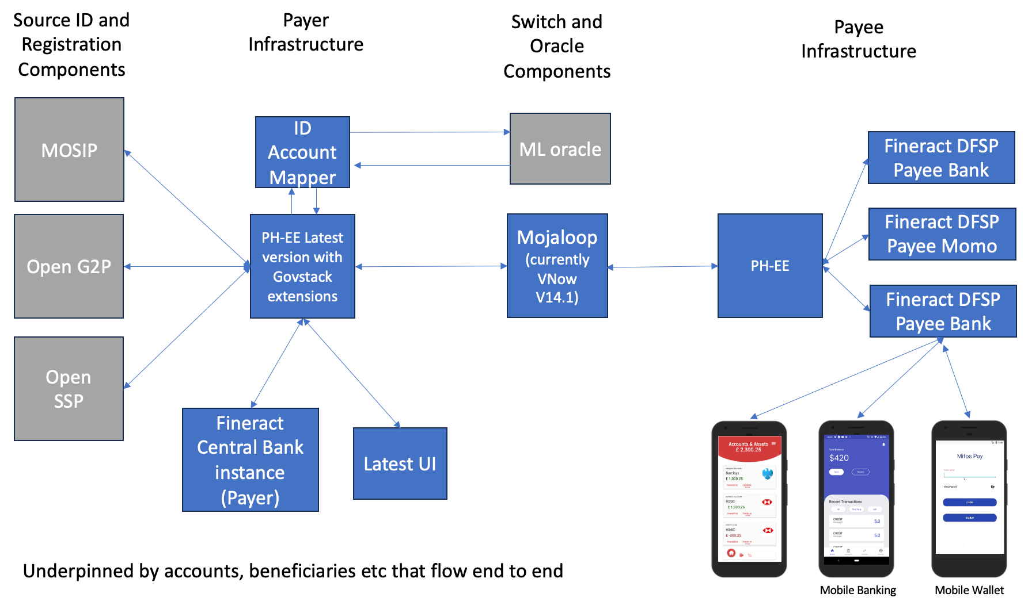
Lab Environment Vision

Slide 42
Lab Environment Vision Roadmap
We see this Lab environment developing not only as we add features but as funding and co-operation allows us to expand. Items we already have as candidates on our roadmap:
Maintained instances of DPG’s to keep them up to date
Directly linking to Open G2P and Open SSP
Direct MOSIP integration
Updated Mojaloop connectors
Allowing different user experiences and component choices as per real-world
Flexible components that can be moulded to use-cases
PISP integration
Demonstrate G2PConnect as well as Govstack interfaces
Pre-defined demos to support conversations

Slide 43


X
A deployable package for Payment Hub EE, Mojaloop and Fineract.
By Elijah Okello

Slide 44
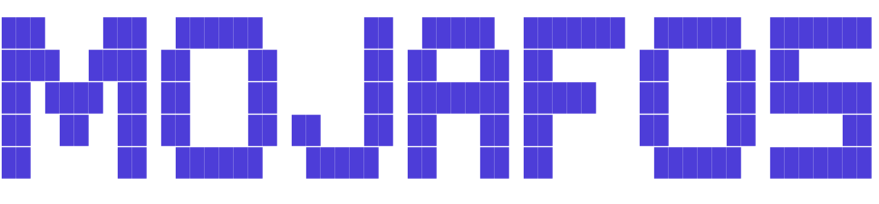
Mojafos
What does it do ? Simplifies deployment of Payment Hub, Mojaloop and Fineract(s) for DEMO purposes.
Who is it for ? Business people, developers and anyone that wants to explore payment use cases for the softwares.
My experience…
How to get started : https://elijah-gsoc.gitbook.io/mojafos/getting-started
Please submit feedback by creating an issue at the link below:
https://github.com/elijah0kello/mojafos/issues/new

Slide 45
GovStack Deliverables

Slide 46
Key Digital Functionalities
Payment Facilitation: Ensures end-to-end workflow across subsystems and asynchronous processing for diverse payment types and use cases.
Voucher Management: Handles full lifecycle of vouchers, from provisioning to reporting.
Account Lookup Services (Account Mapper): Identifies payee's Financial Service Providers (FSP) for secure payment routing against a token.
Payment Request Initiation: Allows both internal and external systems (e.g., other GovStack Building Blocks) to initiate payment requests.
Payment Gateway: Facilitates interoperability among various Financial Service Providers (FSPs) for specific use cases such as G2P and P2G.
Payment Portal: Enables users to manage complete cycle of sending and receiving payments.
Event Management: Supports events that trigger specific actions based on payment outcomes.
Reconciliation: Ensures financial account accuracy and consistency.

Slide 47
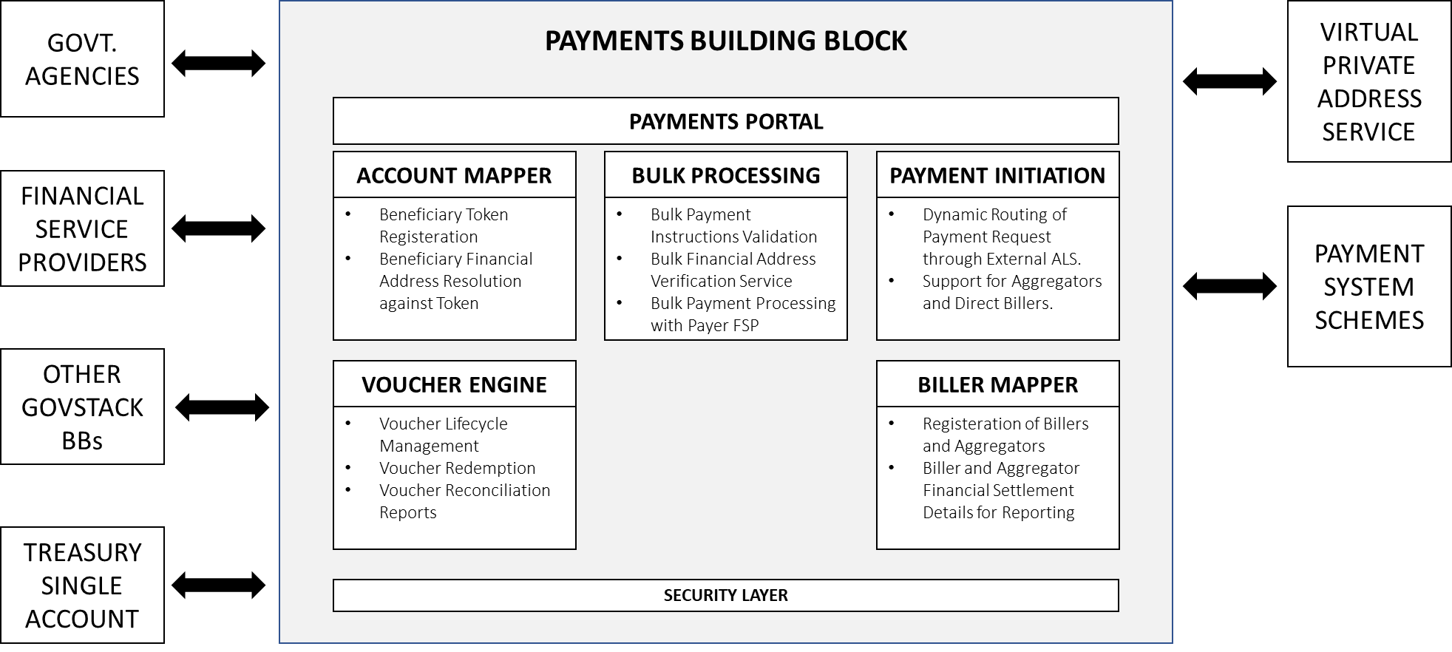
Key Digital Functionalities – BB Components

Slide 48
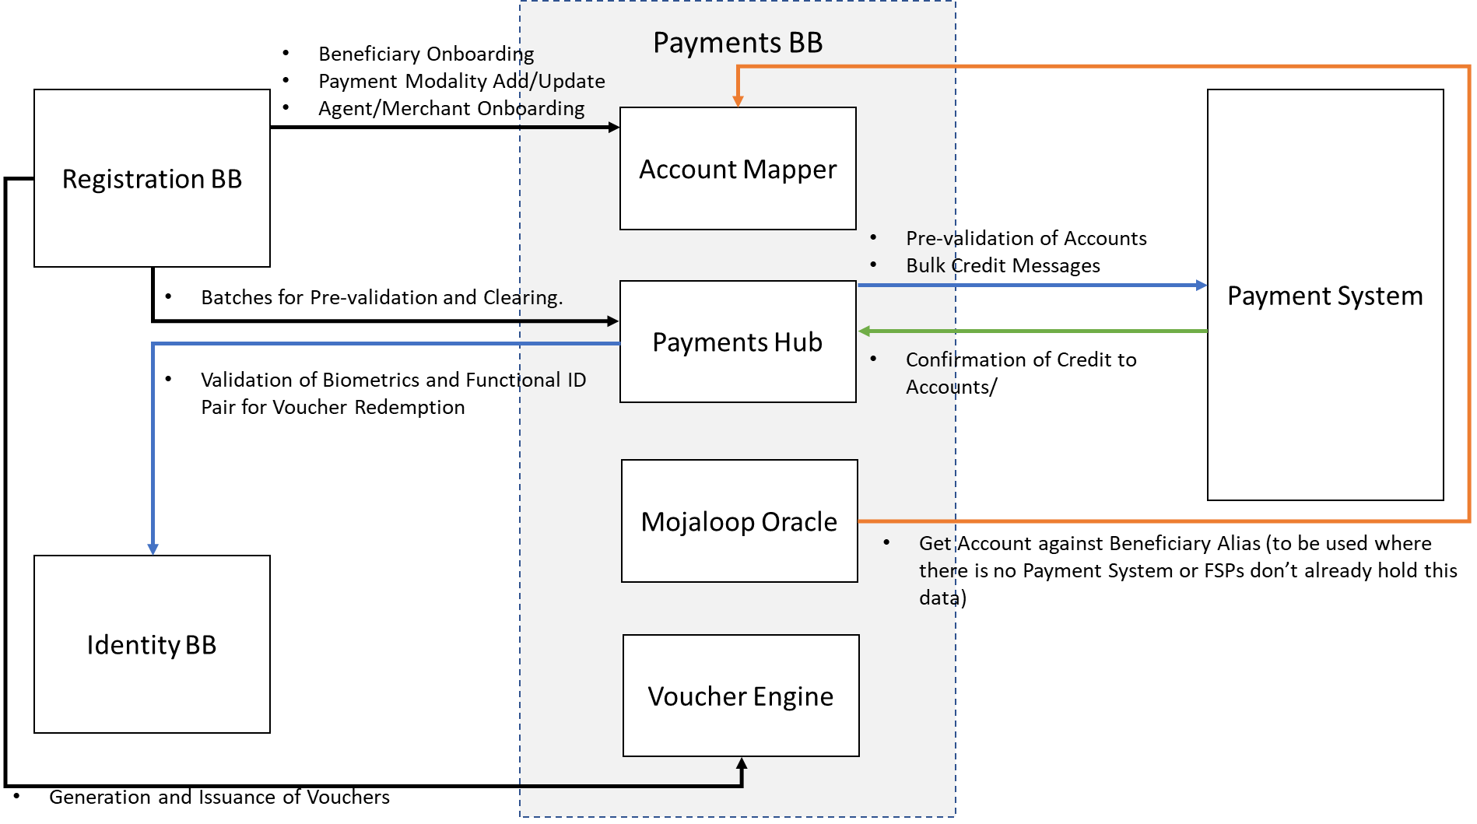
Payments BB Architecture for G2P Payments

Slide 49
Deliverable Breakdown
Over the past 8 months working with GovStack on the Payment BB we have:
Built out the spec’s and updated Payment Hub-EE for G2P, Bulk Disbursement.
Built out the spec’s and implemented an ID Account Mapper.
Built the specs for Voucher Management and P2G and implemented API’s
Updated UI for Payment Hub to factor in many of the new features.
Engaged in country discussions about use-cases and potential implementation opportunities.
Impact: The Govstack approach with the realities we have created underneath is a powerful tool for engaging with countries on DPI adoption. It will drive up adoption of switches and hubs such as Mojaloop which are intrinsically needed as part of the DPI.

Slide 50
Key Digital Functionalities: Account Mapper / Directory
Maps Functional ID of beneficiaries to their payment modality and financial address.
Maintain payment information for beneficiaries of G2P Social Benefit programmes in one location and can be easily updated.
Supports multiple payment channels:
Bank
Mobile money
Vouchers
Payment alias
Information is stored in tokenised format.
More information @ https://govstack-global.atlassian.net/wiki/spaces/GH/pages/285016232/PI2+Design+Documents?focusedCommentId=291831844

Slide 51
Key Digital Functionalities: Bulk Processing Engine
Batch De-bulking: Manages the de-bulking of payment batches based on payee institutions and forwards them to the Payer Bank for further processing.
Funds Validation: Validates that the initiating agency has provisioned sufficient funds before executing a batch payment.
End-to-End Reconciliation: Maintains a reconciliation service to track the status of posted payment instructions at payee institutions.
More information @ https://govstack-global.atlassian.net/wiki/spaces/GH/pages/285016232/PI2+Design+Documents?focusedCommentId=291831844

Slide 52
Key Digital Functionalities: Voucher Engine
Provisioning and Issuance: Facilitates the provisioning, issuance, and activation of vouchers. Sufficient funds must be allocated to the voucher during the provisioning process.
Activation and Usability: Vouchers are issued but are not usable until they are activated. The activation process makes the voucher active and usable for specific use cases and for a limited time.
Redemption: Once activated, vouchers can be redeemed for benefits in the form of cash, products, or services from a third party, such as an agent or merchant.
More information @ https://govstack-global.atlassian.net/wiki/spaces/GH/pages/285016232/PI2+Design+Documents?focusedCommentId=291831844

Slide 53
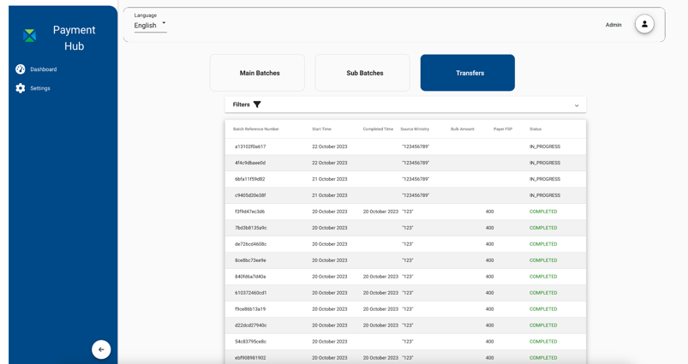
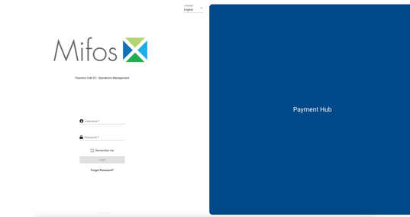
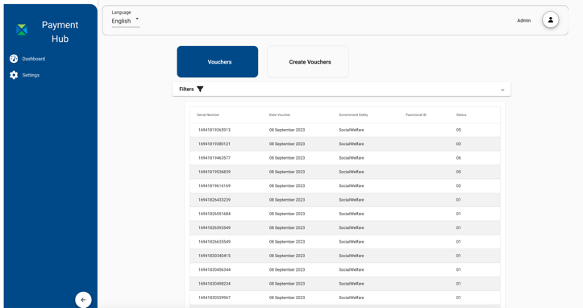
Key Digital Functionalities: Payments Portal
User Management. The Payments Building Block has three kinds of users, Administrators, Government Entity Users and Financial Institution Users.
View list of all payments facilitated by the Payments Building Block.
For Administrative Users and Government Entity Users to view and manage Vouchers.
For Administrative Users only to view the Account Mapper.

Slide 54
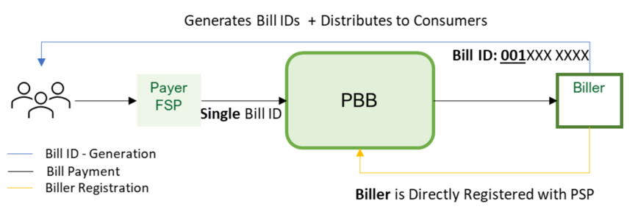
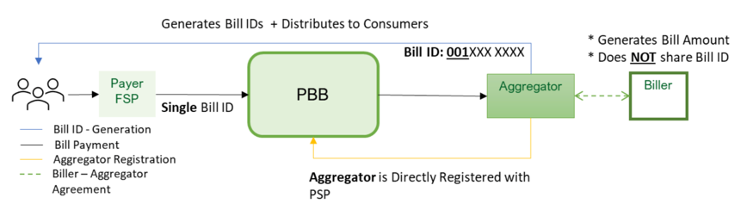
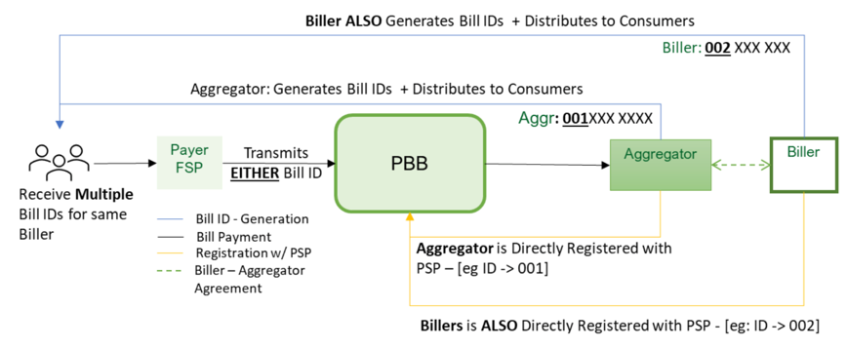
Key Digital Functionalities: Payment Initiation for P2G
3 options supported
Customers receive a single bill ID from the “Biller” directly (no aggregator)
Customers receive a single bill ID from the aggregator
Customers receive multiple bill IDs of the same bill from the Biller or aggregator

Slide 55
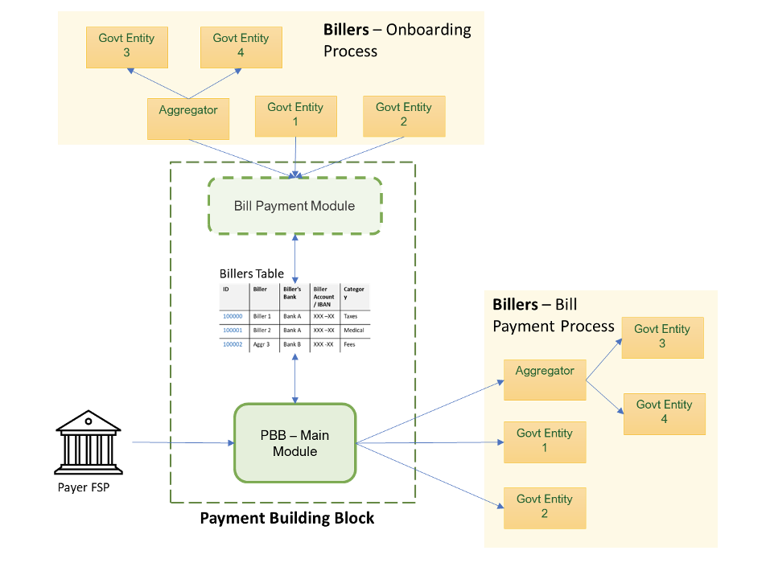
Key Digital Functionalities: P2G High Level Architecture
More information @ https://govstack-global.atlassian.net/wiki/spaces/GH/pages/285016232/PI2+Design+Documents?focusedCommentId=348586145

Slide 56
Where next for GovStack Pay-BB
Currently the Product Council is deciding where next to add effort but there are some areas which will undoubtedly be part of the roadmap:
Expanding to look at G2G, G2B and B2G payments
More direct engagement with countries and development of usecases based on the fundamental building blocks.

Slide 57
G2P Connect Deliverables

Slide 58
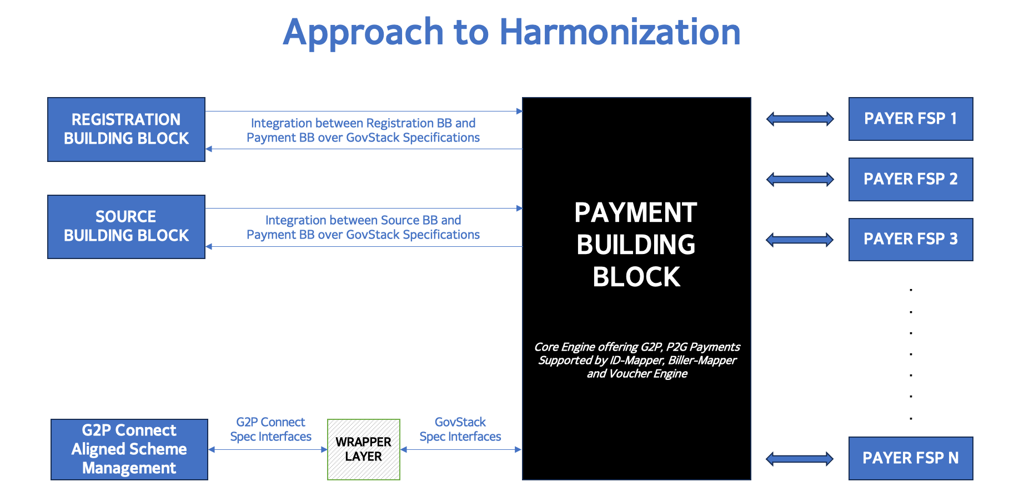
G2P Connect API Harmonization
Join the discussion @ https://github.com/orgs/G2P-Connect/discussions/29

Slide 59
G2P Connect Technical Assessment Framework (TAF)
We have also worked closely with the G2P Connect Technical Assessment Framework (TAF). We have submitted a response for all our DPG components and are awaiting the final independent assessment report. This will mark us based on a wide range of criteria key to implementers.
Following on from this we will be the working on our roadmap against identified gaps that also map directly to feedback from potential implementers.
For example we plan to work on better integration of Fraud and Financial Risk Assessment capabilities with our Mifos DPG’s

Slide 60
Demo

Slide 61
Objectives
As we highlighted earlier we are developing a new Lab environment and we want to show a preview of the first Demo that will be live shortly, some of the capabilities it will have and how it will demonstrate some of the developments we have talked about.
Firstly it show how the ID account Mapper is populated during registration
Then it will show how a set of bulk transactions from a Government USCT programme can be sent to Payment-Hub and referencing the ID-Account mapper split into batches and sent to the relevant DFSP’s through the Mojaloop switch.
It will also show how mobile apps interacting with the DFSP’s enable the end user to understand their balance and undertake transactions through PISP

Slide 62
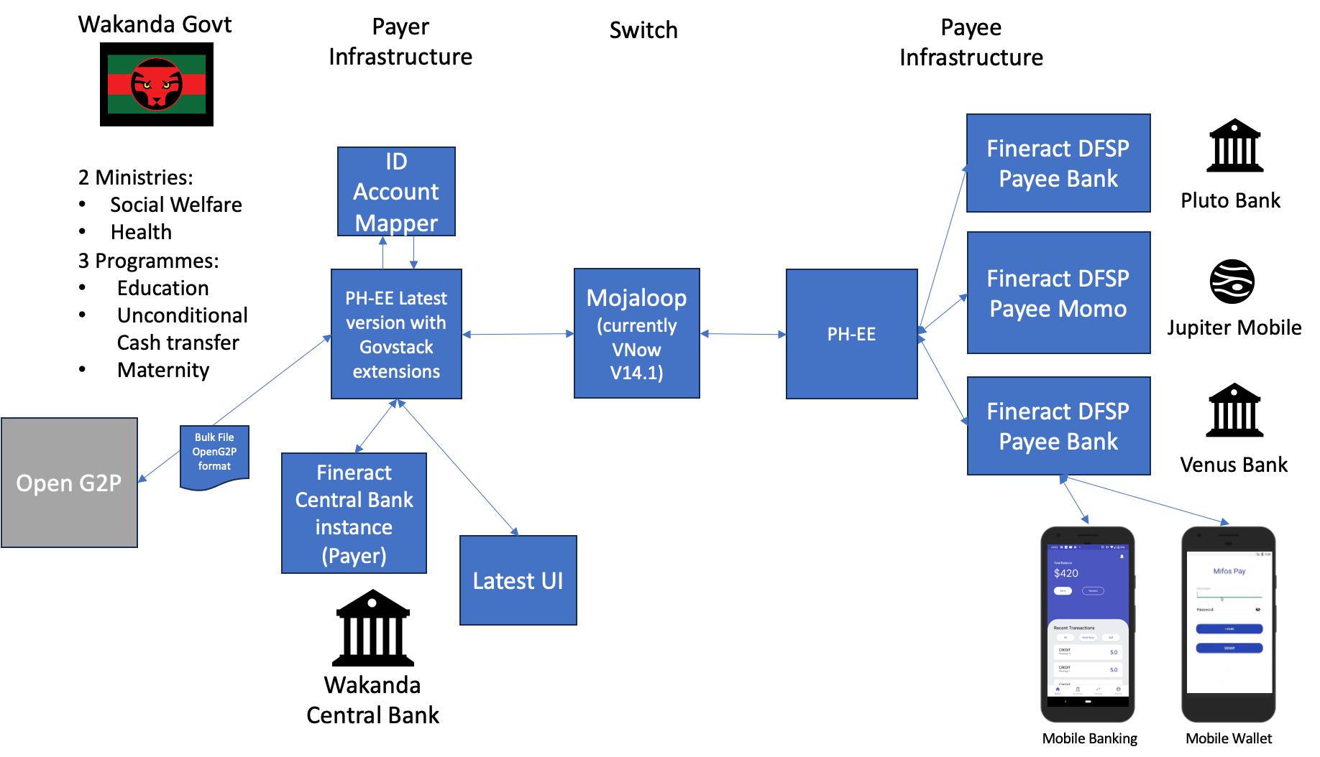
Demo Architecture

Slide 63
Setup
It will have pre-configured as would occur in a deployment the following ministries and programmes in the Payment Hub:
Government Entity | Entity Name
GOV001 | Ministry of Social Welfare
GOV002 | Ministry of Health
Government Entity | Program ID | Program Desc | PayerDFSP | Account Number
GOV001 | P001 | Education Allowance | wakanda.mifos.community | KE22WAKA0000009988771234
GOV001 | P002 | Unconditional Cash Transfer | wakanda.mifos.community | KE22WAKA0000009988123456
GOV002 | P007 | Maternity Benefits | wakanda.mifos.community | KE22WAKA0000009988661234

Slide 64
Setup
It will also have set up the following accounts in the DFSPs:
DFSP | Account Number | Initial Balance
wakanda.mifos.community | KE22WAKA0000009988771234 | 100,000
wakanda.mifos.community | KE22WAKA0000009988123456 | 100,000
wakanda.mifos.community | KE22WAKA0000009988661234 | 100,000
wakanda.mifos.community | KE22WAKA0000009988661239 | 0
venus.mifos.community | KE22VENU0000009988661239 | 0
jupiter.mifos.community | 254170298 | 0
wakanda.mifos.community | KE22WAKA0000009988661000 | 0
wakanda.mifos.community | KE22WAKA0000009988661240 | 0
wakanda.mifos.community | KE22WAKA0000009988662240 | 0
venus.mifos.community | KE22VENU0000009988661240 | 0
jupiter.mifos.community | 254170299 | 0
wakanda.mifos.community | KE22WAKA0000009988661241 | 0
venus.mifos.community | KE22VENU0000009988661241 | 0
jupiter.mifos.community | 254170300 | 0

Slide 65
Population of the ID Account Mapper
We will show through the admin UI that the ID Account Mapper currently doesn’t contain any values.
We will then load a set of beneficiaries using the register beneficiary API.
We will then show this data is populated within the ID Account Mapper.
Government Entity | Program ID | Payee Functional ID | Payee Account Type | Payee DFSP | IBAN/Mobile Account
GOV001 | P001 | GOV001P0015678956789 | Account | wakanda.mifos.community | KE22WAKA0000009988661239
GOV001 | P001 | GOV001P0015678956790 | Account | venus.mifos.community | KE22VENU0000009988661239
GOV001 | P001 | GOV001P0015678956791 | Mobile Money | jupiter.mifos.community | 254170298
GOV001 | P001 | GOV001P0015678956000 | Account | wakanda.mifos.community | KE22WAKA0000009988661000
GOV001 | P002 | GOV001P0015678956792 | Account | wakanda.mifos.community | KE22WAKA0000009988661240
GOV001 | P002 | GOV001P0015678956892 | Account | wakanda.mifos.community | KE22WAKA0000009988662240
GOV001 | P002 | GOV001P0015678956793 | Account | venus.mifos.community | KE22VENU0000009988661240
GOV001 | P002 | GOV001P0015678956794 | Mobile Money | jupiter.mifos.community | 254170299
GOV002 | P007 | GOV001P0015678956795 | Account | wakanda.mifos.community | KE22WAKA0000009988661241
GOV002 | P007 | GOV001P0015678956796 | Account | venus.mifos.community | KE22VENU0000009988661241
GOV002 | P007 | GOV001P0015678956787 | Mobile Money | jupiter.mifos.community | 254170300

Slide 66
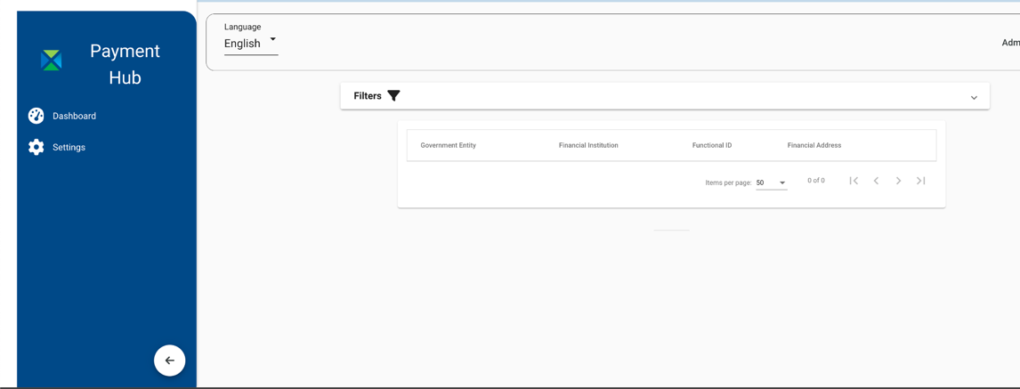
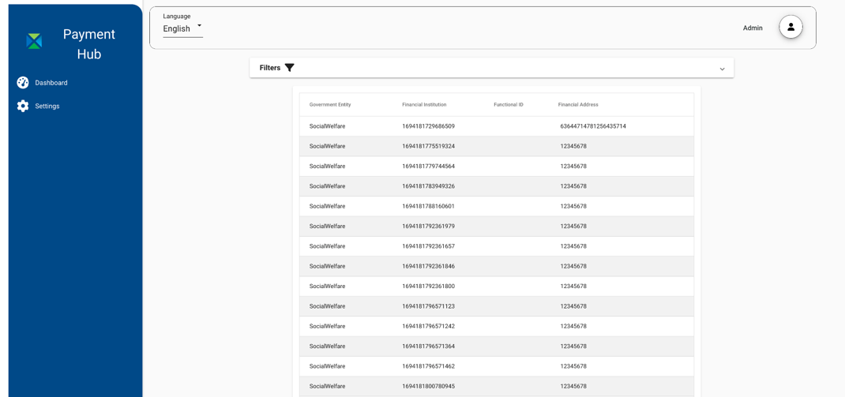
Population of the ID Account Mapper

Slide 67
Running Bulk Transactions
We will show the Balances of the accounts match those initial balances we shared
We will then represent a set of bulk data being sent from a system such as OpenG2P by uploading the following to the bulk API.
Transaction Set
Batch ID | Gov Entity | Program ID | Bene Functional ID | Amount
BULK001 | GOV001 | P001 | GOV001P0015678956789 | 350
 |  |  | GOV001P0015678956790 | 400
 |  |  | GOV001P0015678956791 | 350
 |  |  | GOV001P0015678956000 | 400
Batch ID | Gov Entity | Program ID | Bene Functional ID | Amount
BULK002 | GOV001 | P002 | GOV001P0015678956792 | 2000
 |  |  | GOV001P0015678956793 | 2000
 |  |  | GOV001P0015678956794 | 4000
 |  |  | GOV001P0015678956892 | 4000
Batch ID | Gov Entity | Program ID | Bene Functional ID | Amount
BULK003 | GOV002 | P007 | GOV001P0015678956792 | 2000
 |  |  | GOV001P0015678956793 | 2000
 |  |  | GOV001P0015678956794 | 4000

Slide 68
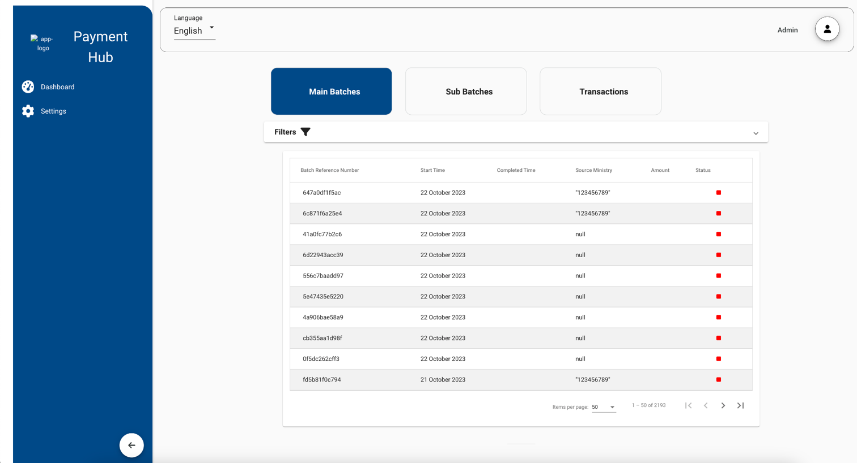
Running Bulk Transactions
We can look at the transaction history we can see these transactions have been imported and broken down into sub-batches in the Admin UI.

Slide 69
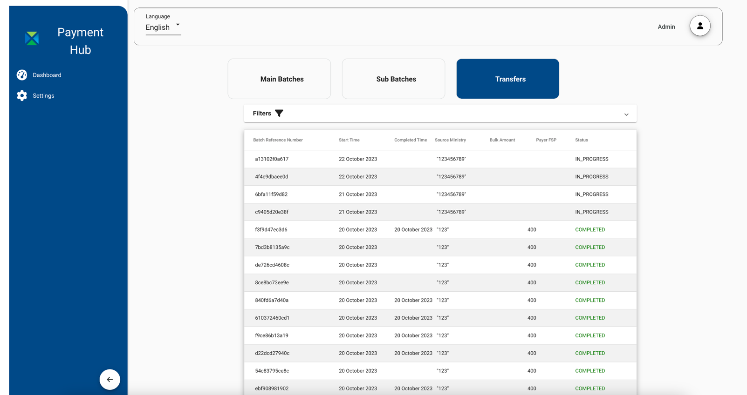
Running Bulk Transactions
We can look at the transaction history we can see these transactions have been imported and broken down into sub-batches in the Admin UI.

Slide 70
Running Bulk Transactions
We can also look at the balances of the accounts and see that the Payer accounts have been debited and the Payee accounts credited according to the transactions we processed..
DFSP | Account Number | Initial Balance | Closing Balance
wakanda.mifos.community | KE22WAKA0000009988771234 | 100,000 | 98,500
wakanda.mifos.community | KE22WAKA0000009988123456 | 100,000 | 88,000
wakanda.mifos.community | KE22WAKA0000009988661234 | 100,000 | 92,000
wakanda.mifos.community | KE22WAKA0000009988661239 | 0 | 350
venus.mifos.community | KE22VENU0000009988661239 | 0 | 400
jupiter.mifos.community | 254170298 | 0 | 350
wakanda.mifos.community | KE22WAKA0000009988661000 | 0 | 400
wakanda.mifos.community | KE22WAKA0000009988661240 | 0 | 2000
wakanda.mifos.community | KE22WAKA0000009988662240 | 0 | 4000
venus.mifos.community | KE22VENU0000009988661240 | 0 | 2000
jupiter.mifos.community | 254170299 | 0 | 4000
wakanda.mifos.community | KE22WAKA0000009988661241 | 0 | 2000
venus.mifos.community | KE22VENU0000009988661241 | 0 | 2000
jupiter.mifos.community | 254170300 | 0 | 4000

Slide 71
Demonstrating Mobile Applications

Slide 72
What’s Next
Product & Technology
Complete Mojafos Project
Complete PISP App Project
Collaborate on G2P Use Case Demo
Merchant Workstream Integration
Bulk Payment Integration
FARM Integration
vNext integration
Rollout Lab Environment
Deeper OpenG2P/OpenSPP integration
Community
Deeper Alignment with Mojaloop Accelerator Program
Increased Collaboration on POCs
Mutually advance 50-in-5 DPI Goal

Slide 73


Thank You.
github.com/openMF
edcable@mifos.org | @edcable
dhiggins@mifos.org
github.com/apache/fineract
payments.mifos.org
dpi.mifos.org (coming soon)

Slide 74
Backup Slides

Slide 75
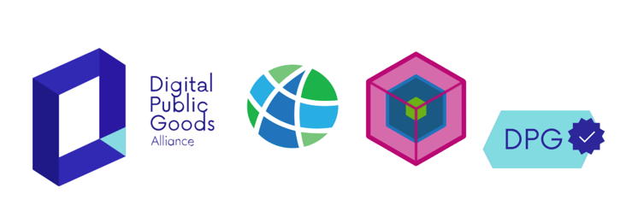


Open Source Building Blocks for Core Banking & Payment Orchestration
Modern, cost-effective highly connected composable banking infrastructure to:
Advance financial health of 3B underbanked.
Commoditize core banking software.
Unlock virtuous cycle of upstream contribution & shared innovation.
Enable global ecosystem of market-driven solutions & services.
25,000,000 clients reached by 500+ institutions across 65 countries powered by our open APIs.
2006. Launch at Grameen Foundation
2011. Independent 501(c)3
2017. Top-level Apache Project

Slide 76
Benefits of Payment Hub EE
Ease of integration with external payment systems
Seamless & Easy to Use - Abstracts out complexity of API integration
Operational Control Center - Enables DFSP to monitor, analyze & respond to payment transactions in real-time
Scalable & Enterprise-Grade
Flexible deployment options - fully containerized, PH-EE can be deployed on-premise or in the cloud
Different deployment scenarios: 3 different configurations based on the level of availability, fault tolerance and transaction volume
barebone | medium | fully scaled
Multi-tenant: Shared service providers offering services to multiple smaller DFSPs to spread out operational costs
Flexible & Extensible
Core Banking System Agnostic
Connect to any core banking or account management system simply by building another connector.
Flexible Payment Bridge
Connect to any other payment system simply by building additional connectors such as SEPA, SWIFT, ISO 20022, or any mobile money API.
Extensible Architecture
Simply build additional connectors for payments, core banking systems, or channel applications.
Orchestrate these different microservices by creating new BPMN diagrams and Zeebe workers.
Payment and Process Orchestration
Zeebe: Powered by Camunda’s modern workflow engine for microservices orchestration built by Camunda.

Slide 77
Why DFSP Participation Toolkit should be Open
Lower Total Cost of Ownership
Accelerated Development
Focus On Differentiation & Value-Add
Freedom from Vendor Lock-In
Sustainable Business Models
Fuels Adoption
OPEN
Virtuous Cycle
Catalyzes Ecosystem
Enables Innovation

Slide 78
Value Proposition
Enabling Access & Meaningful Usage of DFS
MFIs can digitize and digitally transform.
Payment Hub allows simple and low-cost participation in scheme.
Mifos X provides flexible, open production-ready system to digitize all providers, formal & informal.
- Directly offer digital financial services
- Use Open Banking API to partner with fintechs
Rules
Rails
Accounts
Apps
Payment Hub facilitates easy connection to Mojaloop
Mobile Wallet Management System with Core Banking Built-in
MMOs can easily roll out adjacent loan & savings services
MMOs can evolve to become payment & service platforms

